Slide 1
Visual Collaboration Solutions
CAE Visualization & Collaboration in PLM/SDM environment
Prasad Mandava
prasad@vcollab.com
Ph: 248 835 6880

Slide 2
VCollab Overview
VCollab established in 2000
VCollab HQ at Troy, MI
Develop and market VCollab brand of Software Solutions
Many major Automotive and Aero Space OEMS are using the VCollab solution as the visual collaboration platform for sharing CAx (modeling & simulation) data
VCollab provides a common light-weight CAE Data Visual Collaboration platform to PLM/SDM Vendors i.e. “pdf or jt like solution for CAE”

Slide 3
CAE Visualization & Collaboration
Data, data, and more data, and then even more data
Many CAE applications and many formats
CAE results files are very large
Increased usage of CAE is dramatically increasing the number of simulations and large result files ( usage of more HPC is resulting in bigger files .. )
Higher level tools (DOE, Systems Engineering, Robust Engineering, stochastics…) will cause data to explode
FEA
NASTRAN
ANSYS
MARC
ABAQUS
LS DYNA
…
PRE/POST
HM
SOFY
Animator
ANSA
Patran
…
CFD
FLUENT
STARCD
…
PRE/POST
EnSight
ANSA
TecPLOT
…
Analysis / Simulations
Notes:
3

Slide 4
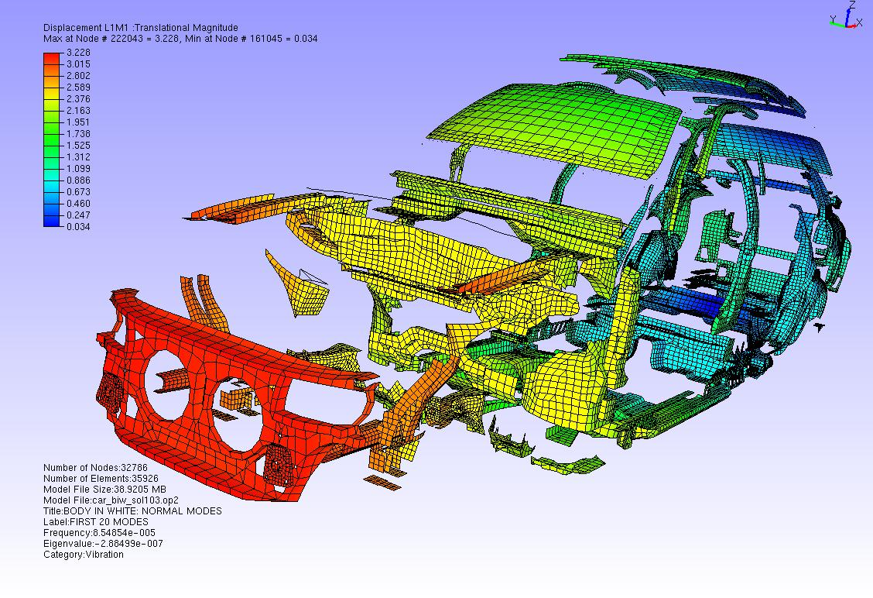
CAE Visualization & Collaboration
CAE data is complex and varied
Many CAE applications and many formats – no standard
Complex field results for different physics
Solid Mechanics
Fluid Mechanics
Electro Magnetics
Acoustics
Others …
Transient results
2D images are not enough
2D movies are not enough
Data files are HUGE !!!
Notes:
4

Slide 5
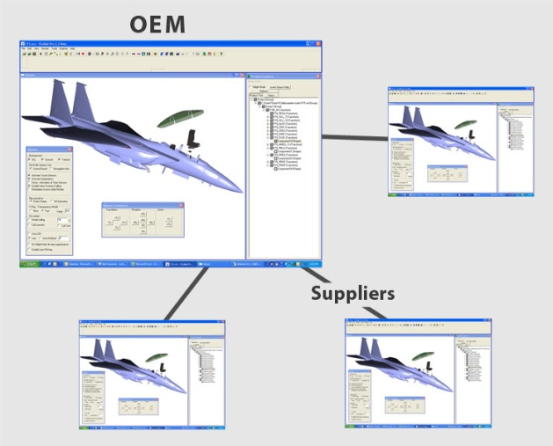
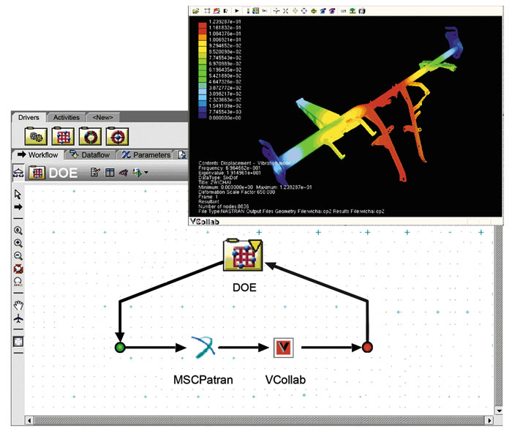
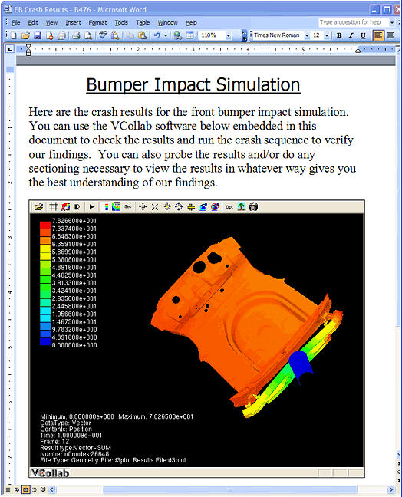
CAE Visualization & Collaboration
Multiple use cases for CAE Visualization & Collaboration
Integration with PIDO / PLM/ SDM processes with metadata and report generation
Simulation review (peer & management)
Presentation & collaboration
Data Archival
Notes:
5

Slide 6
VCollab Solution 1-2-3
1) Extract & Compress key results (attributes) from FEA/CFD output into a common and ultra compact format 3D CAX.
2) Create ViewPoints / Story Board / Report (optional step) -> 3D CAX
3) View with Lightweight Viewer
.ODB
.CASE
.OUT
.OUT
.CAS
.ENCASE
.bdf
.CCM
.ODB
.CAX
.CAX
.CAX
.D3PLOT
.FIL
.ODB
.RTH
.CAS
.FIL
.PAT
.CAX
.CAX
.CAX
.ODB
.RTH
.CCM
.ENCASE
.D3PLOT
.CASE
.RTH
.CAX
.CAX
.CAX
.RTH
.PAT
.D3PLOT
.CCM
.CAX
.CAX
.CAX
.FIL
.FIL
.bdf
.CCM
.CAS
.OUT
.CAX
.CAX
.CAX
.ENCASE
.CAS
.bdf
.OUT
.PAT
.CAX
.CAX
.CAX
.PAT
.CASE
.bdf
.D3PLOT
.ENCASE

Slide 7
CAE Visualization & Collaboration
PLM/SDM environment needs:
Support for common functionality across a broad range of CAE applications formats
Translators from many CAE solutions to common format
Data reduction for access and archival
Automated metadata extraction
Advanced visualization for design/analysis reviews
Simple and common visualization for management & non-technical reviews
Automated CAE report generation
FEA
NASTRAN
ANSYS
MARC
ABAQUS
LS DYNA
…
PRE/POST
HM
SOFY
Animator
ANSA
Patran
…
CFD
FLUENT
STARCD
…
PRE/POST
EnSight
ANSA
TecPLOT
…
Analysis / Simulations
Notes:
7

Slide 8
VCollab Approach
Provide universal compact CAE format (.CAX)
Proprietary VCollab format
Reduces CAE data upto 99%
Provide automated metadata extraction
Provide CAE data translation and reduction tools (VMOVE) to create CAX files
VMOVE CAE - Supports most of the leading CAE software.
VMOVE API – for non-supported and in-house codes
Provide Easy to use, professional, light weight CAE Viewers (VCollab)
Provide integration with general tools
Provide automated CAE report generation
FEA
NASTRAN
ANSYS
ABAQUS
LS DYNA
SDRC
CFD
FLUENT
STARCD
…
PRE/POST
EnSight
Mesh + Transient Data
CAX .. Common Light Weight Data Model/Format

Slide 9
CAX .. Sample File Size Reductions
CAE Software | CAE Results File Size ( MB) | CAX File Size (MB) | File size reduction | Time for translation
ABAQUS | 2930 | 47.4 | 98% | 3 Mins
MSC NASTRAN | 289 | 46.4 | 84% | <1 Min
MSC MARC | 243 | 23.9 | 90% | >1 Min
ANSYS | 14000 | 92 | 99% | ~ 1 Hr
LS DYNA | 363 | 145 | 60% | <1.5 Min
FLUENT | 347 | 13.1 | 96% | < 1 Min
Notes:
The file size reductions vary based on a variety of factors. The % vary around 50 to 99%. The key is that VCollab provides tools to the users to set the reduction criteria and control these file size reductions.
Note: Need to filter and then compress to get maximum savings. Compression alone is not enough.
9

Slide 10
CAX .. reduce further by filtering
CAE Software | CAE Results File Size ( MB) | CAX File Size (MB) | File size reduction | Time for translation
ABAQUS (9 results) | 310 | 35.1 | 88% | < 2 Min
ABAQUS ( One result extracted) | 310 | 6.85 | 97% | < 1 Min
Notes:
The file size reductions vary based on a variety of factors. The % vary around 50 to 99%. The key is that VCollab provides tools to the users to set the reduction criteria and control these file size reductions.
Note: Need to filter and then compress to get maximum savings. Compression alone is not enough.
10

Slide 11
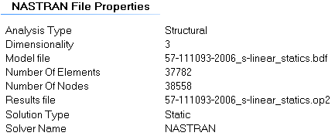
VCollab Approach
Provide Automated metadata extraction (VMoveCAE)
Separate executable provided as part of VMoveCAE
Works across all VMoveCAE supported formats
Extracts metadata and places it into xml file
Xml file can be flavored for specific formatting needs
Extensible data extraction

Slide 12
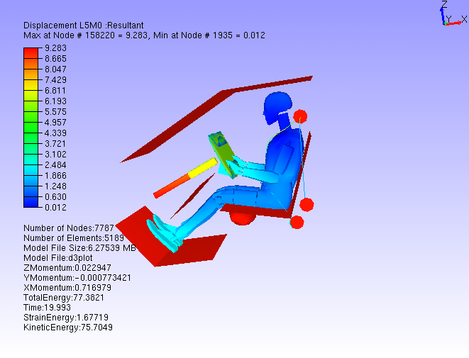
VCollab Approach
Provide easy to use, professional, light weight CAE Viewers (VCollab)
VCollab Presenter Lite (Reader)
free CAX viewer
VCollab Presenter
Plug-in to PLM/SDM
allows for CAX data exploration
VCollab Pro
allows for CAX authoring
allows for combining CAX files
allows for custom annotations
allows for creation of viewpoints
Allows for automated CAE report generation

Slide 13
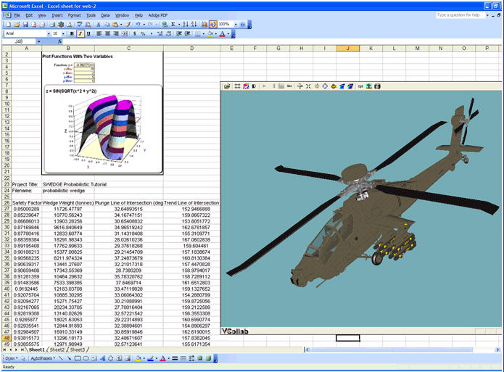
VCollab Approach
Provide interfaces with general tools
Internet Browser
MS/Office
MS SharePoint

Slide 14
VCollab Approach
Provide Automated report generation (VMove)
Separate executable provided as part of VCollab Pro license
Works across all VMoveCAE supported formats
Generates 3D as well as 2D PPT reports
Looking to extend to html and PDF
Early stages of release / development

Slide 15
VCollab Solution for CAD, FEA and CFD
CAD
FEA
CFD
Static
Simulation
Simulation
VMoveCAD
VMoveCAE
Highly Reduced Visualization Format *.CAX
Common Viewing Platform: VCollab
VCollab
Presenter Lite
VCollab
Presenter
VCollab
Pro
Free Viewer
3D Documents
Interactive 3D .ppt
Interactive 3D .doc
Web
High Performance
Visualization &
Document creation tool
Notes:
15

Slide 16
VCollab Solution for CAE: Reduce,Visualize,Share CAE Data
.
Durability
NVH
Crash
Safety
CFD
Thermal
Static
Static
Simulation
Simulation
Simulation
VMoveCAE .. Universal Data Reduction Engine / Translator
Highly Reduced Visualization Format *.CAX
VCollab
Presenter Lite*
VCollab
Presenter
VCollab
Pro
* Free Viewer
3D Documents
Interactive 3D .ppt
Interactive 3D .doc
Web
High Performance
Visualization &
Authoring tool
Notes:
16
Here is how the Vcollab solution fits into the CAE ecosystem. Data from different simulation domains can be converted into one common CAX format.
As you see, CAX is the center of the solution architecture. VMoveCAE is the translator that generates CAX from many popular CAE software.
There are three options to select from that enable you to visualize CAX files.
VCollab Presenter Lite is the freely downloadable viewer for the desktop. Vcollab Presenter Lite is like the Adobe Acrobat Reader. It’s a free download, so anyone can get what they need to view your CAX files. Once installed, all users have to do is double click on a CAX file and it opens in VCollab Presenter Lite. It’s that simple.
Vcollab Presenter can also be purchased to add additional post-processing features for decision support such as data probing, changing legend scales, finding hot spots, vector plotting, and integration with Microsoft Office tools. It’s easy to use, easy to deploy by IT and would be an essential tool for everyone to view and understand the CAE data.
VCollab Pro is the tool created for content authors like analysts. Using Vcollab Pro, one can edit and create specific views or 3D slides of the model that they like to share/present. Vcollab Pro is the authoring tool you can use to put the content you want to publish in the form you want people to see.

Slide 17
VCollab supported CAE Applications & Formats
Natively Supported CAE Software | Formats Supported | Remarks
ABAQUS | ODB, FIL, INP | Supports V6.10
MSC.NASTRAN, NX.NASTRAN | OP2, BDF | Supports Complex Eigen Vectors
MSC.MARC | T16 and t17 plot files
ANSYS | RST, RTH, RFL
LS-DYNA | D3PLOT files, key Files
FLUENT | Binary Output (.CAS and .DAT files)
ENSIGHT GOLD | .CASE, .ENCASE
PATRAN | .PAT, .OUT files
Star-CD (Star-CCM) | .CCM
Notes:
Here are the CAE applications and the formats, that are currently supported by VCollab.
We continue to support more and more tools every year.

Slide 18
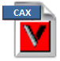
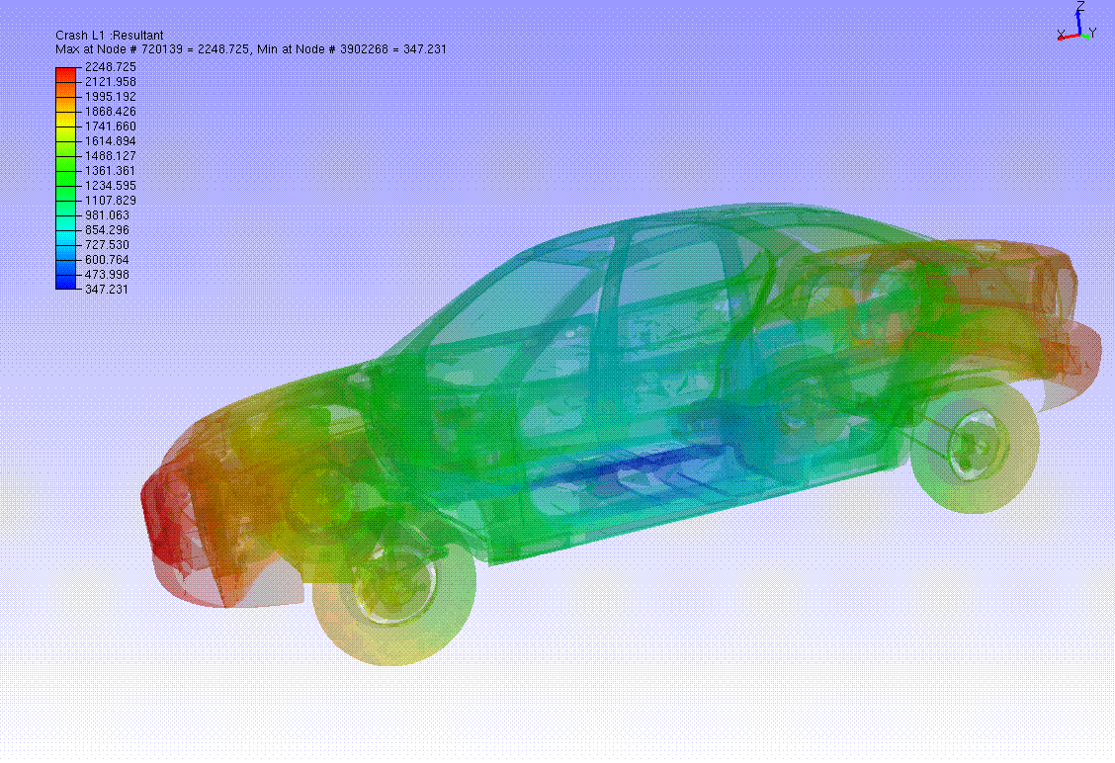
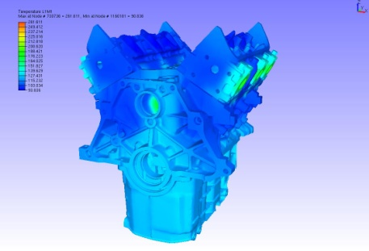
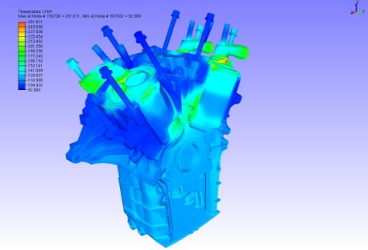
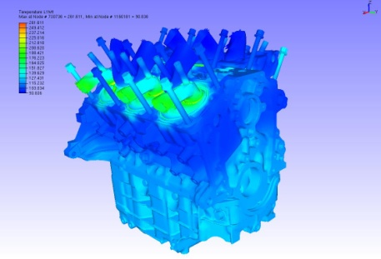
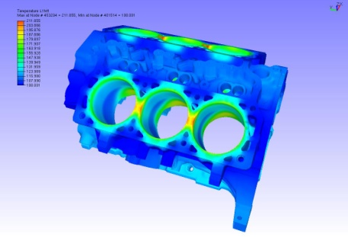
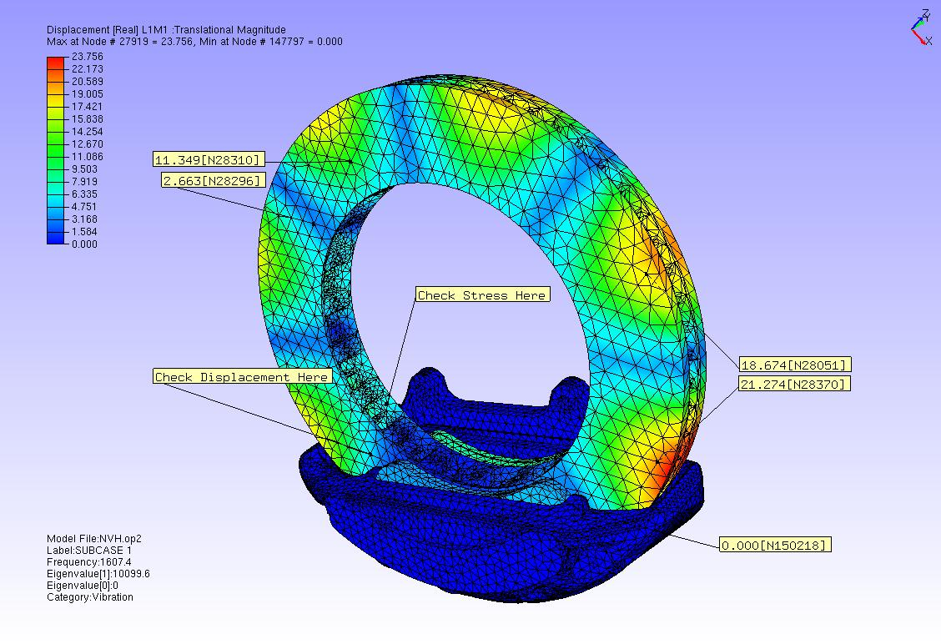
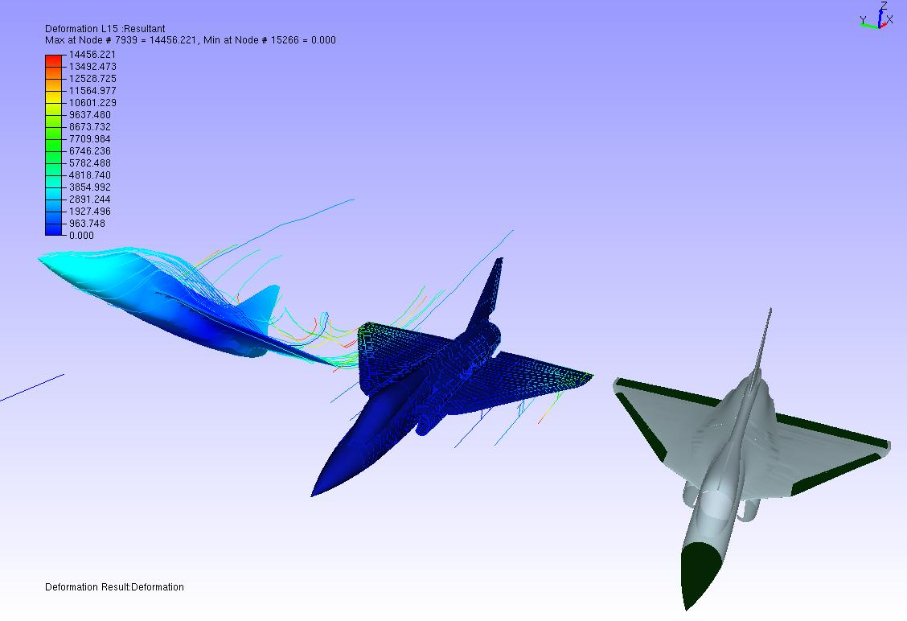
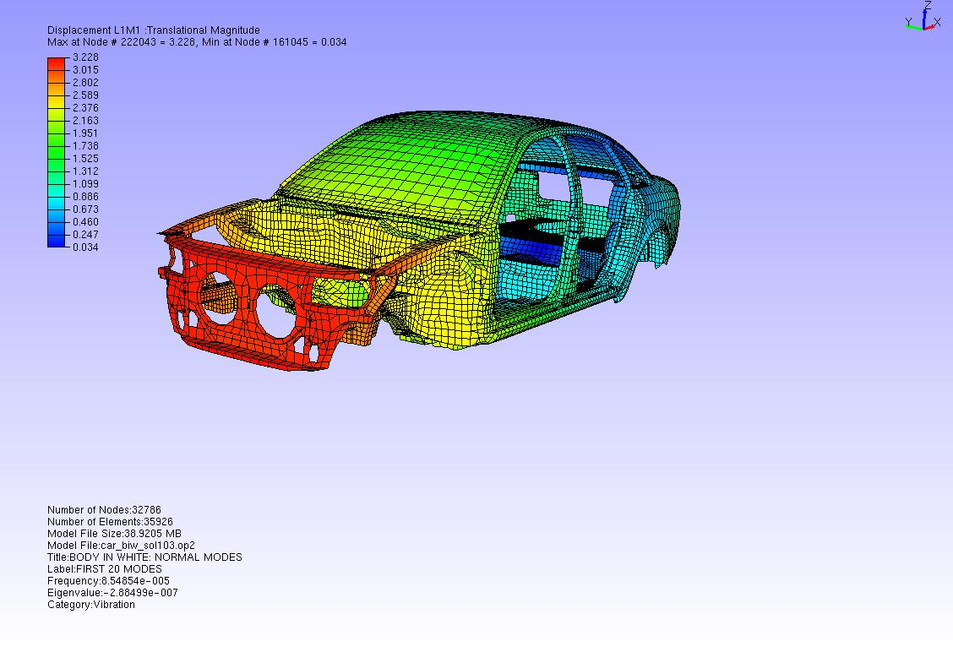
VCollab
Light-Weight, CAE/CAD Data Visual Collaboration Platform
PDF of CAE Data !!
Create CAE Animation/Movies
“View Point”
Merged View
[CFD(Fluent)+FEA(Nastran)+CAD(CATIA)]
Probe CAE Data
Explode View

Slide 19
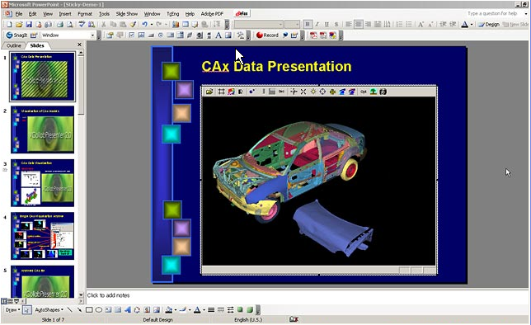
Interactive 3D Presentation / Documentation
with MS-Office
3D PPT
3D DOC
3D XLS
Notes:
I am sure, most of you heard about 3D PDF. With VCollab, you can make 3D PPT, 3D DOC, 3D XLS documents.

Slide 20
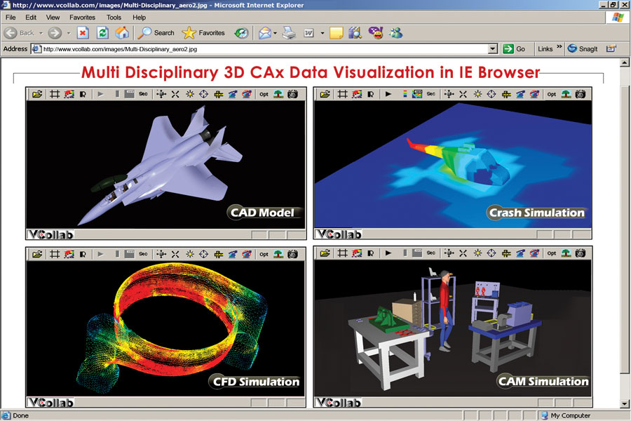
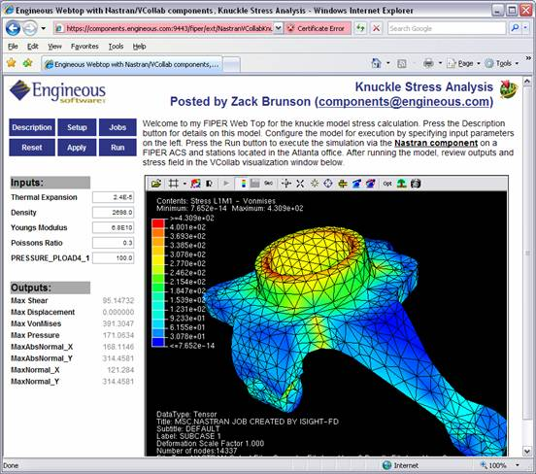
Integration with Web
Integration with
Simulation Process Management
Web Integration
Notes:
Similarly, CAX files can be integrated into WEB pages.
Significant point to note is that the CAX files and VCollab Viewer are integrated with many CAE process management systems as well as Simulation Data Management systems.

Slide 21
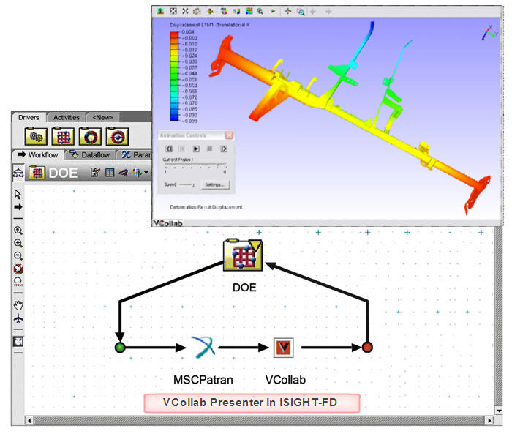
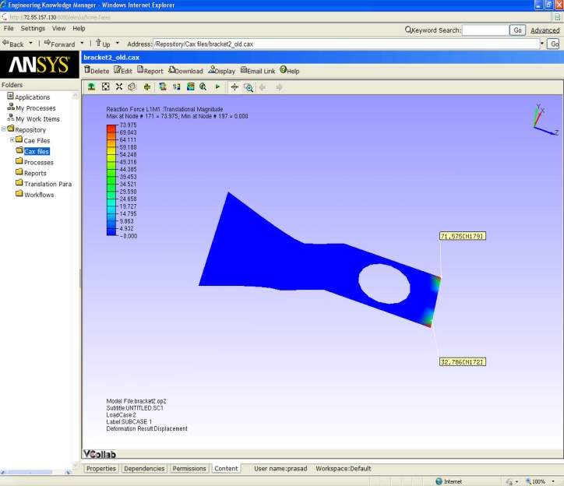
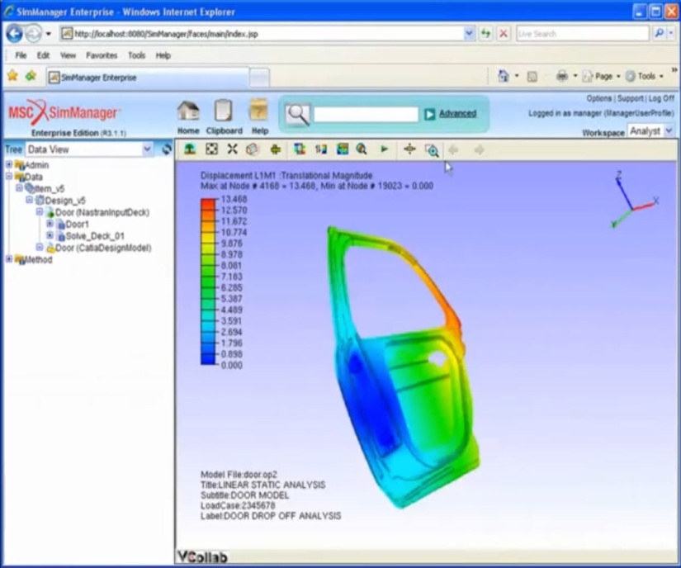
Integration with Data Management Systems
Simulia/SLM
MSC/SimManager
Phoenix Analysis Library
Ansys/EKM
MS SharePoint
Team Center Simulation

Slide 22

VCollab within the Data Management Systems
VMoveCAE in batch mode
CAX Generator
Meta Data Extractor
Report Generator
VCollab Presenter Viewer

Slide 23
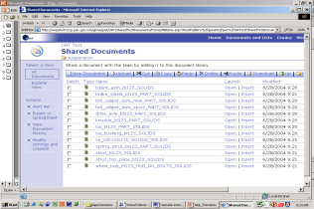
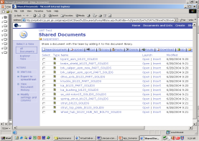
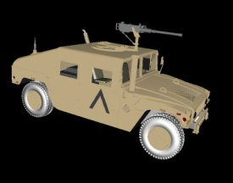
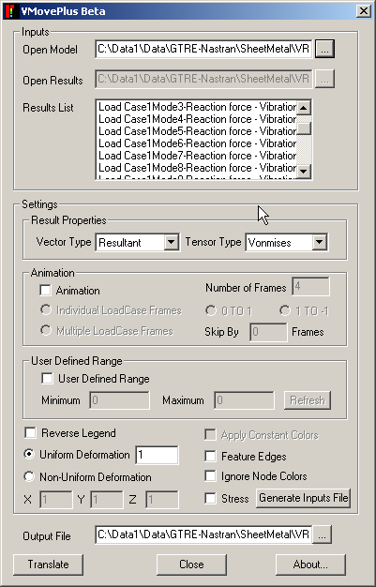

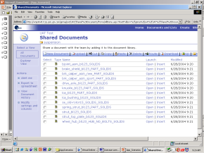
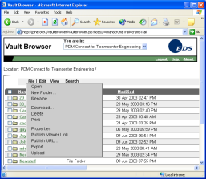

Typical VCollab Deployment scenario within PLM/SDM
Suppliers
CAE/CFD
Engineer
VCOLLAB
PRESENTER
SLM
LICENSE SERVER
VMOVECAE
SLM
CAX
CAE Engineer
Location 1
Data
Extract
Compress
WEB SERVICE
SLM
VCOLLAB
PRESENTER
LICENSE SERVER
ABAQUS
https
CAE/CFD
Engineer
NASTRAN/DYNA
SLM
FILE
SERVER
HQ
CFD Engineer
Location 2
StarCD/FLUENT
NFS
VCOLLAB
PRESENTER
Benefits
Light weight CAE data sharing strategy with dramatic file size reductions
Improved collaboration with easy to use CAx viewer
DISK
STORAGE
SLM
DRE/DE
Location 3
Notes:
23

Slide 24
VCollab Approach
Provide universal compact CAE format (.CAX)
Proprietary VCollab format
Typically 95% or greater compressions rates
Provide automated metadata extraction
Provide CAE data reduction tools (VMOVE) to create CAX files
VMOVE CAE - Supports most of the leading CAE software.
VMOVE API – for non-supported and in-house codes
Provide Easy to use, professional, light weight CAE Viewers (VCollab)
Provide integration with general tools
Provide automated report generation
FEA
NASTRAN
ANSYS
ABAQUS
LS DYNA
SDRC
CFD
FLUENT
STARCD
…
PRE/POST
EnSight
Mesh + Transient Data
CAX .. Common Light Weight Data Model/Format

Slide 25
THANKS
Prasad Mandava
prasad@vcollab.com
Ph: 248 835 6880

